Slide 1
Salary Prediction Project
Brandon Lin

Slide 2
Dataset Visualization
What is the overall spread of the data?

Slide 3
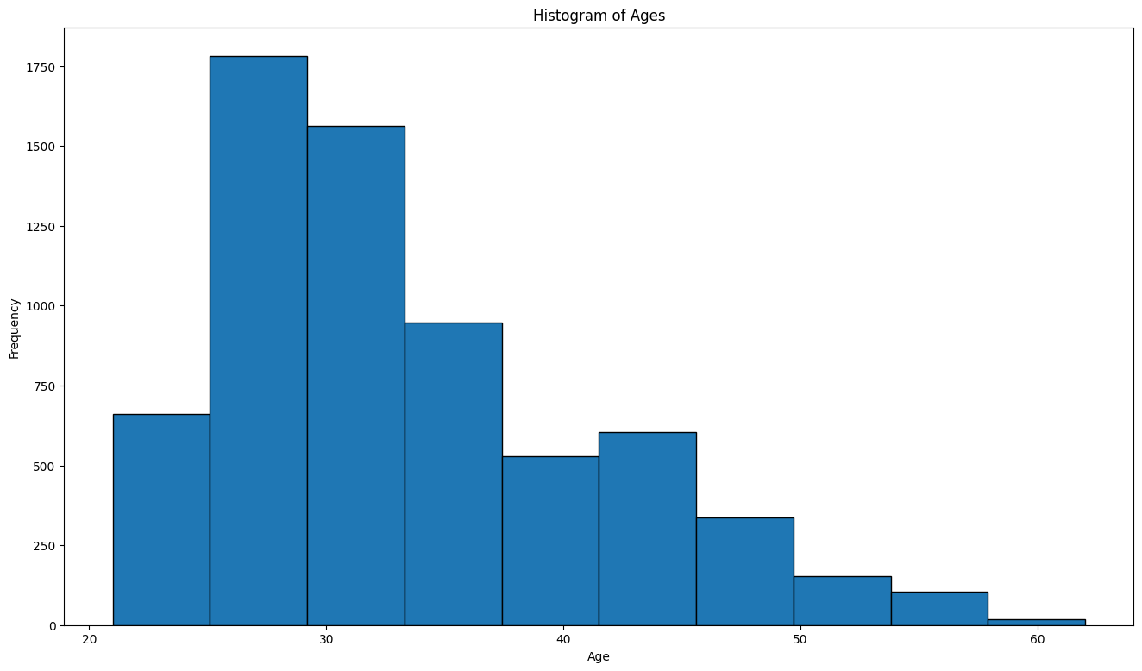
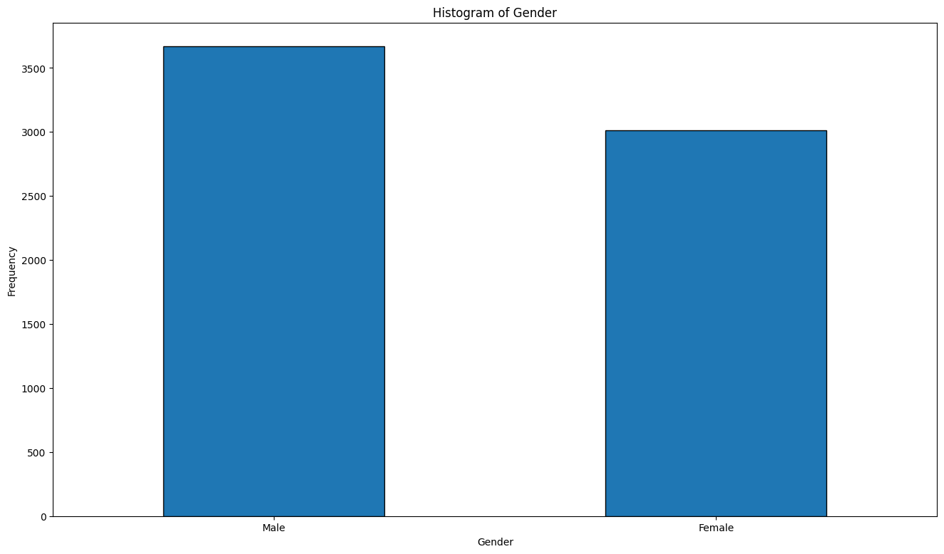
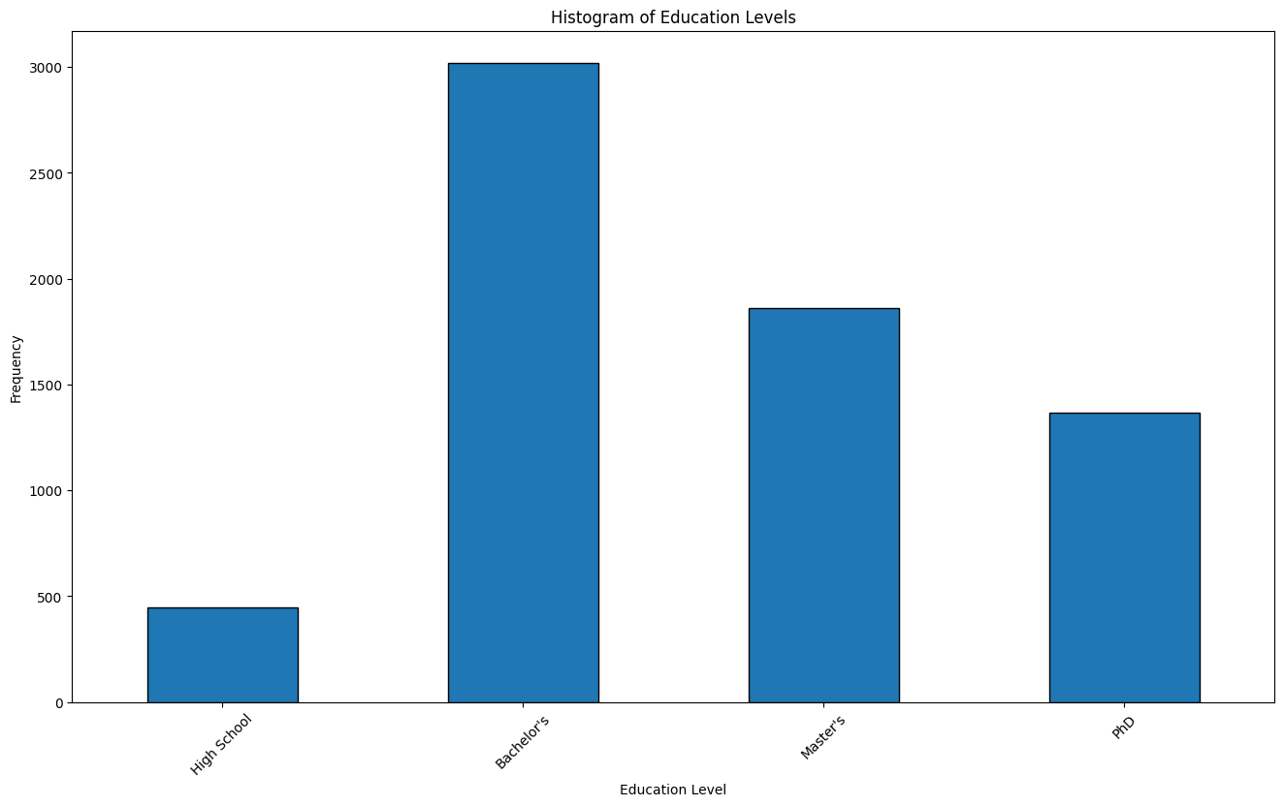
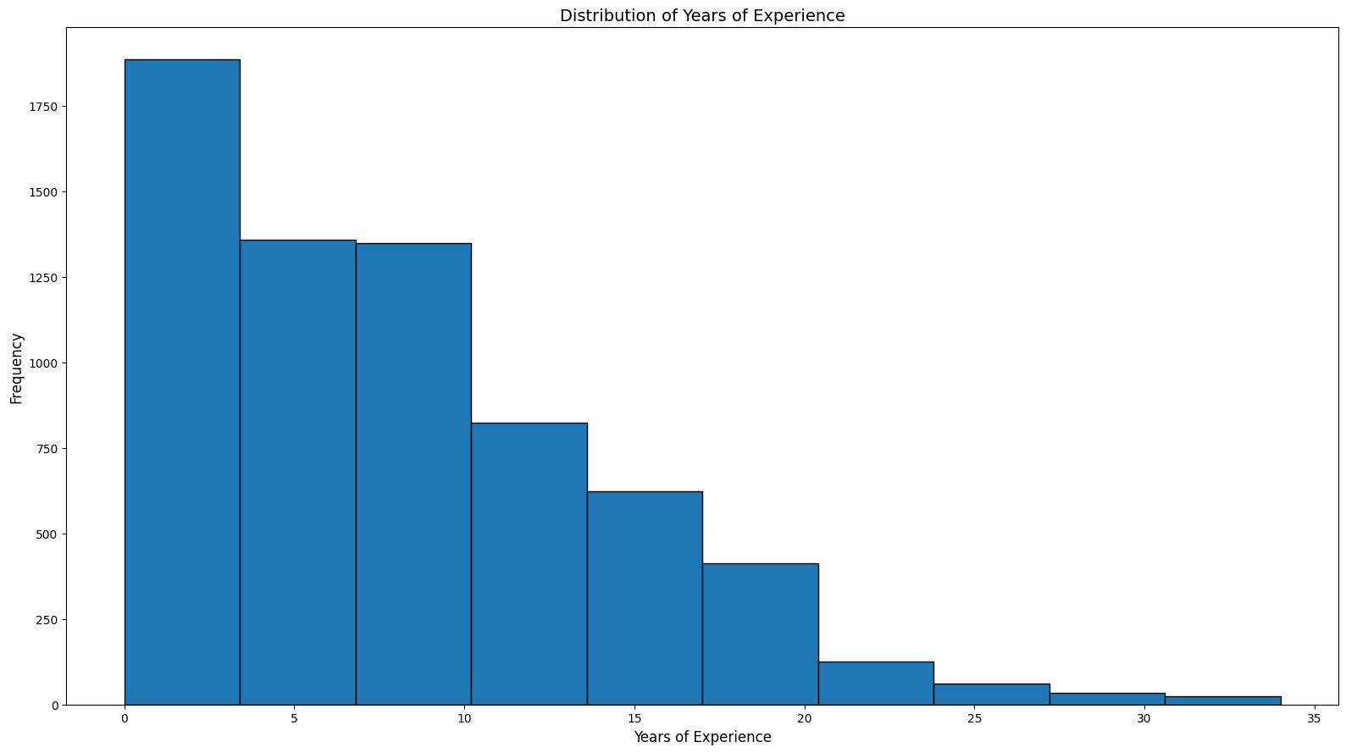

Slide 4
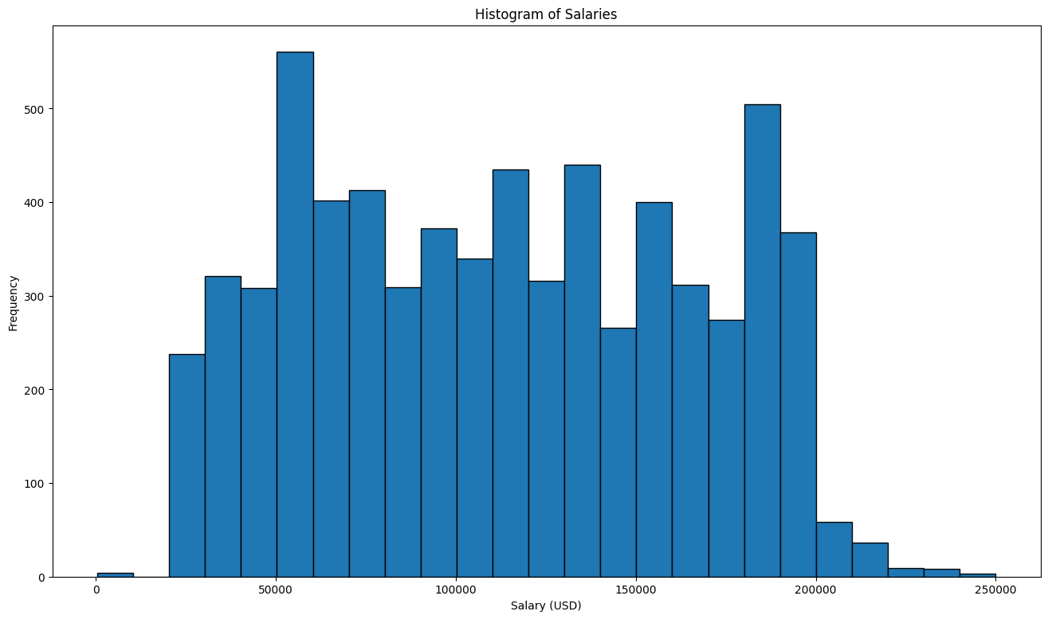

Slide 5
Relationships
Are there any relationships that are meaningful?

Slide 6
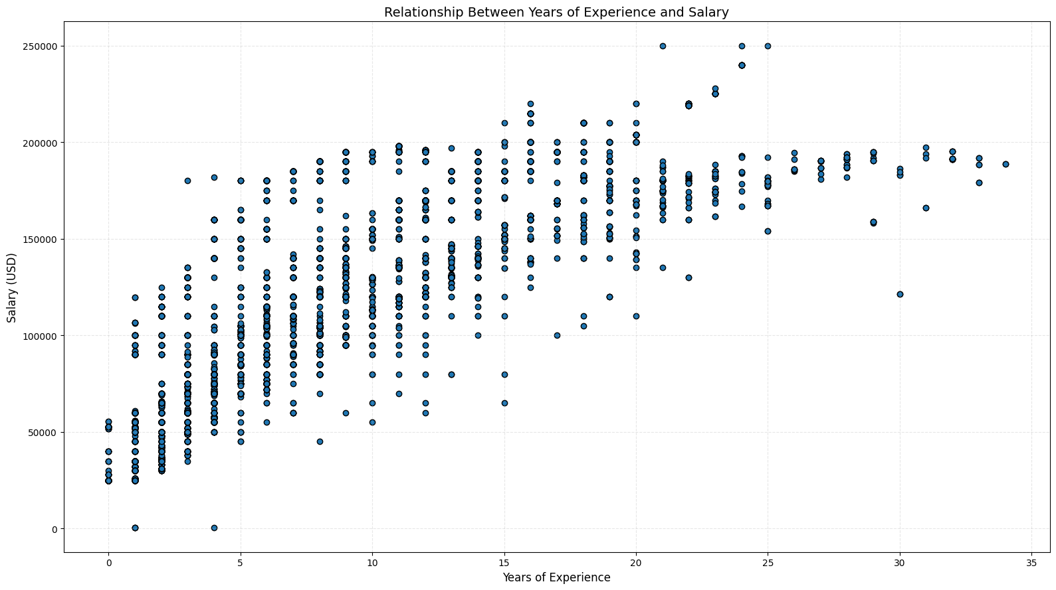

Slide 7
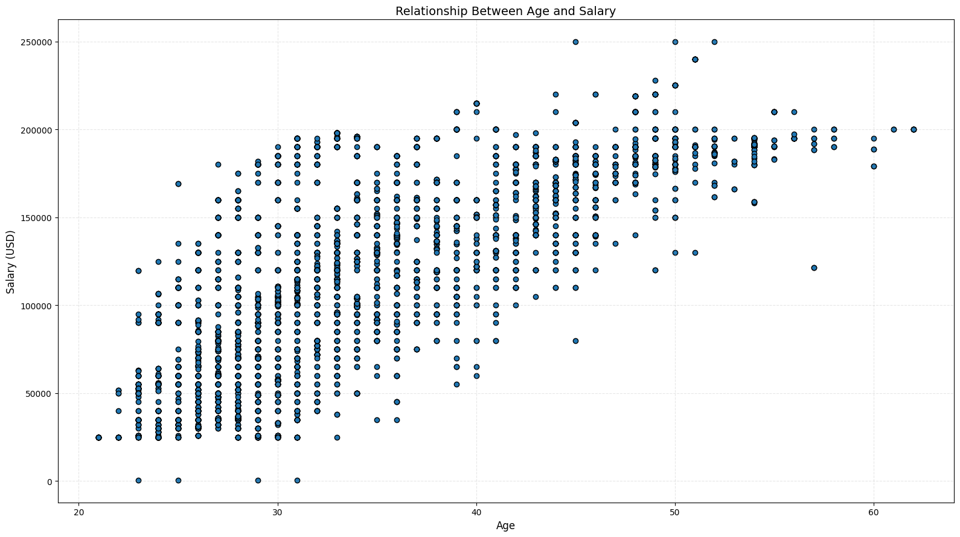

Slide 8
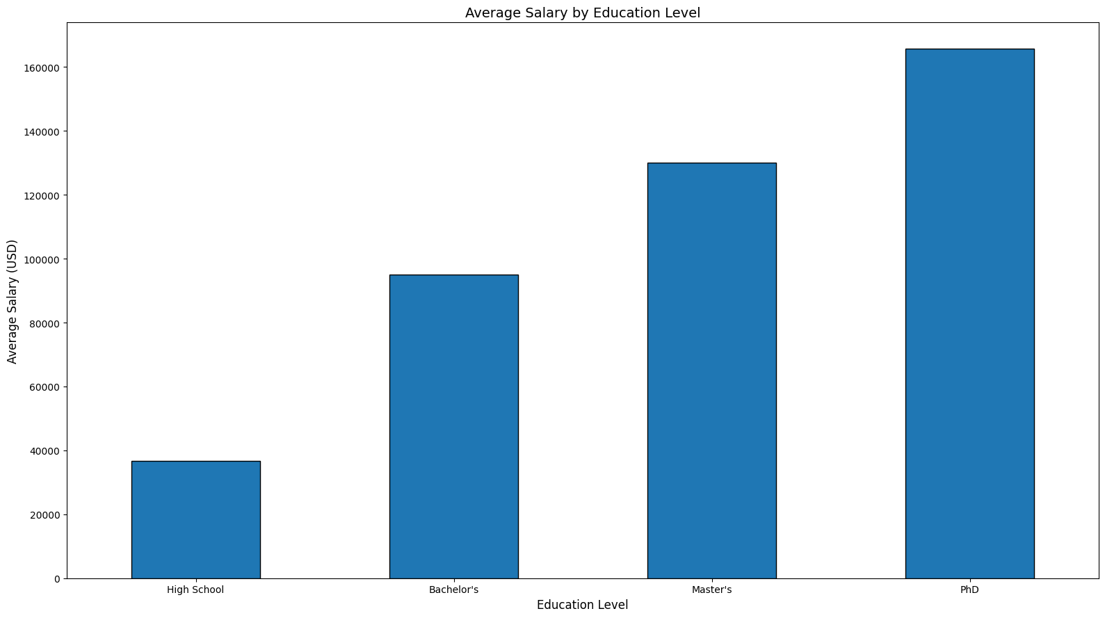

Slide 9
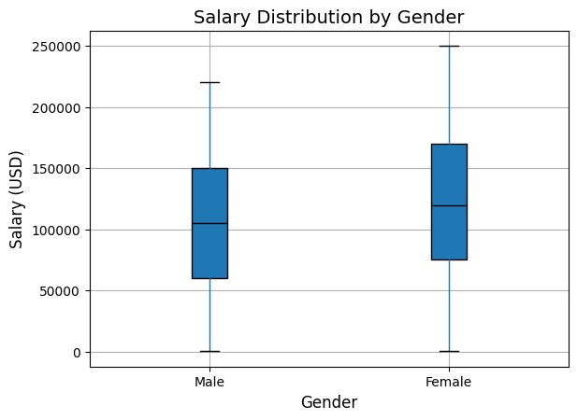

Slide 10
Reverse Pay Gap?
Is there a reason for a discrepancy in pay?

Slide 11
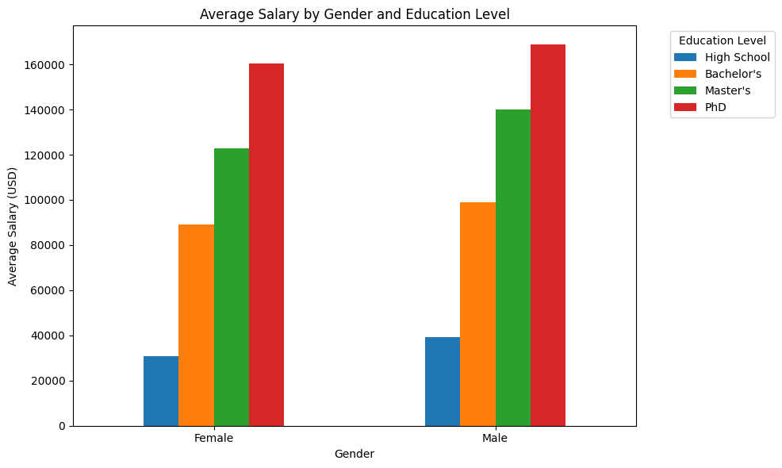

Slide 12
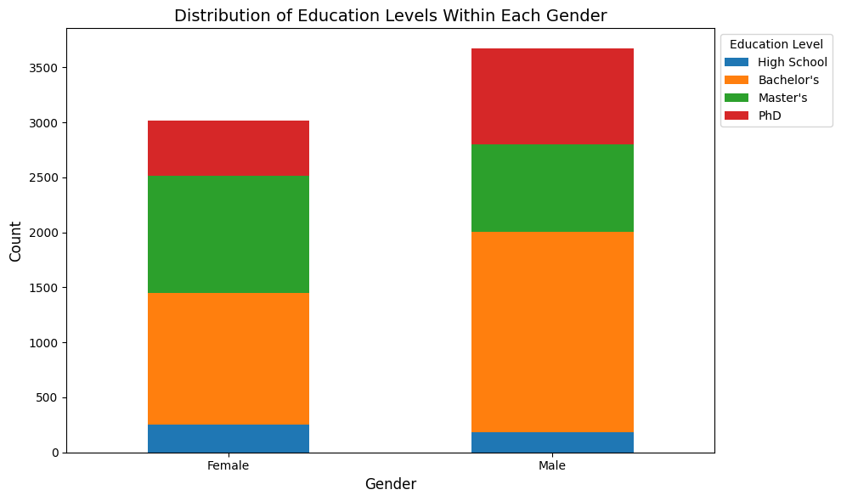

Slide 13
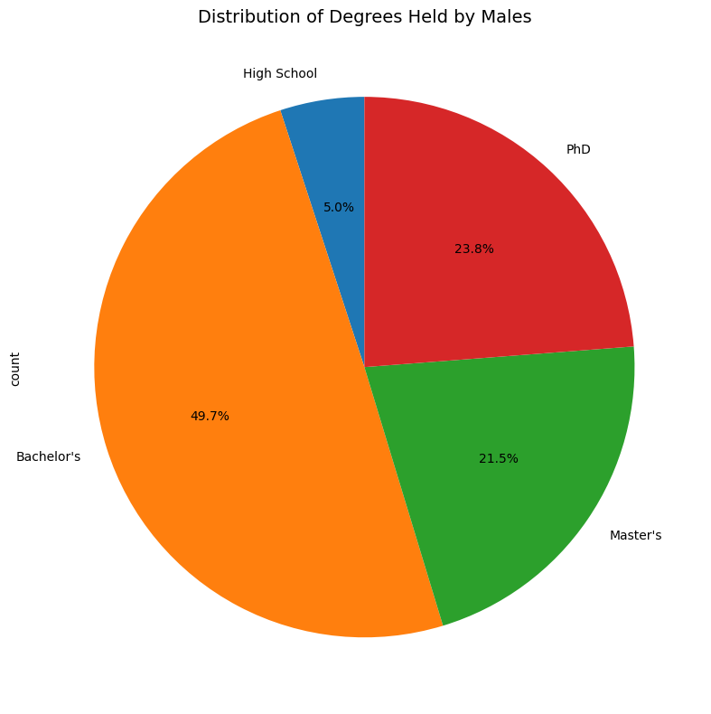
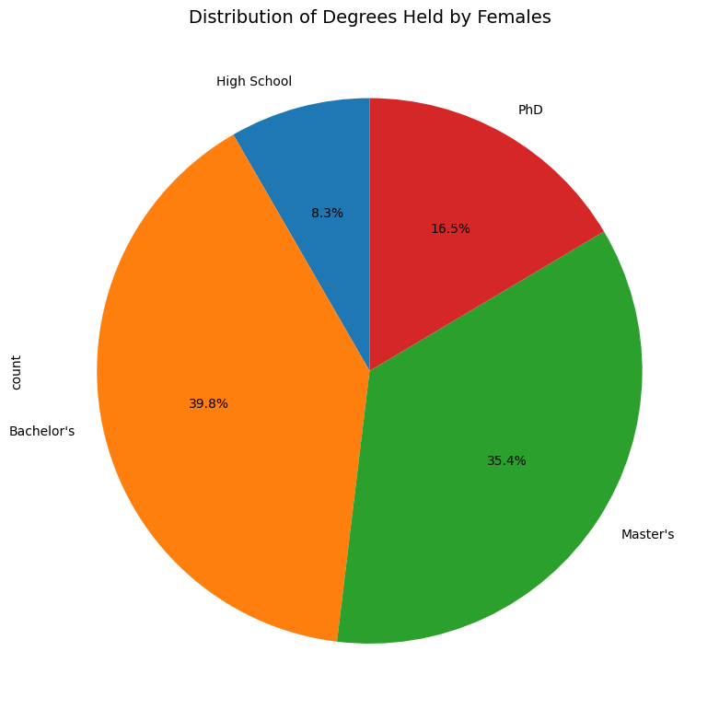

Slide 14
Heatmap
Time to analyze correlation formally

Slide 15
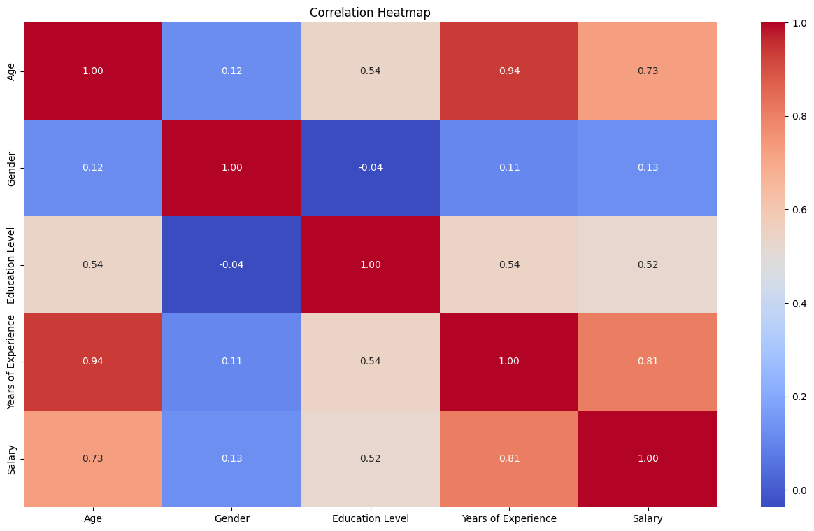

Slide 16
Predictive Models and Performance
Let’s take a look at the predictive models used

Slide 17
Models
Ridge Regression
Random Forest Regressor
Overview: A linear regression technique enhanced with L2 regularization to shrink coefficients and prevent overfitting.
Adds the squared magnitude of the coefficients (multiplied by a penalty term, λ) to the loss function.
Overview: Random Forest Regressor builds multiple decision trees during training and averages their predictions, improving accuracy and reducing variance (Ensemble Method)
Uses Bootstrap Sampling to prevent overfitting. (Bagging)

Slide 18
Model and Performance
Ridge Model
Random Forest Regressor Model
Mean Absolute Error (MAE): 0.35567413963390565
Mean Squared Error (MSE): 0.20758432457804746
R² Score: 0.797155866570255 ~ 0.80
Mean Absolute Error (MAE): 0.2032429930400899
Mean Squared Error (MSE): 0.10644569797550738
R² Score: 0.895984991125628 ~ 0.90

Slide 19
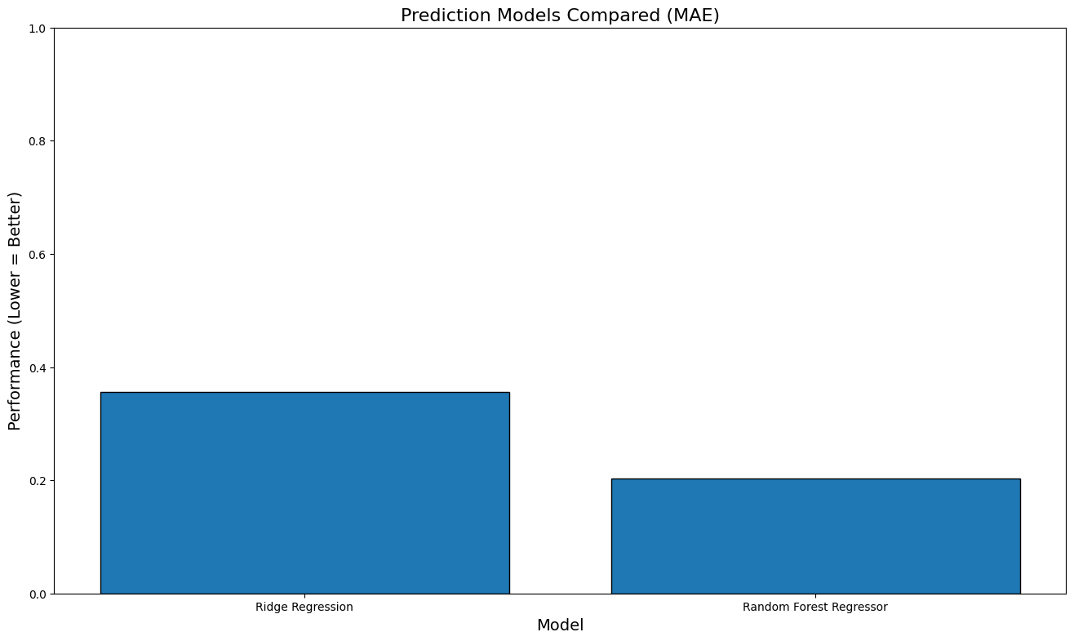
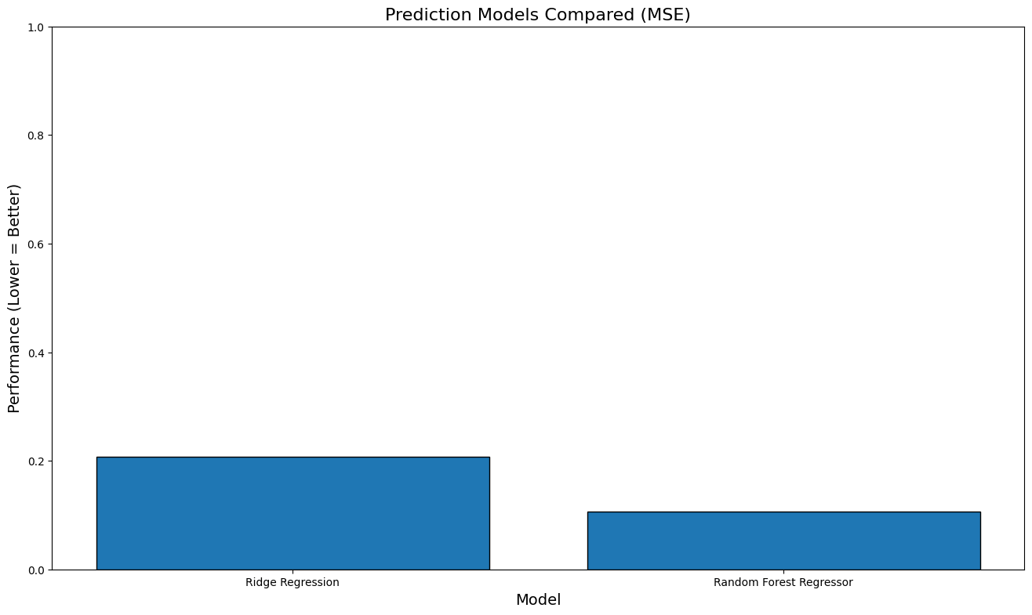
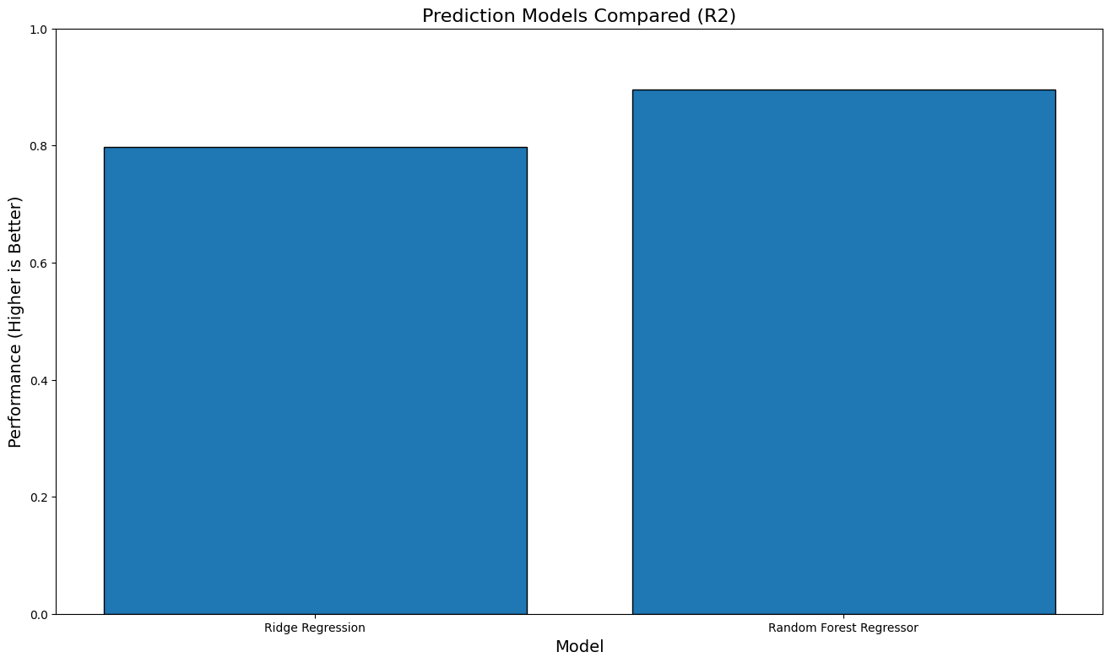

Slide 20
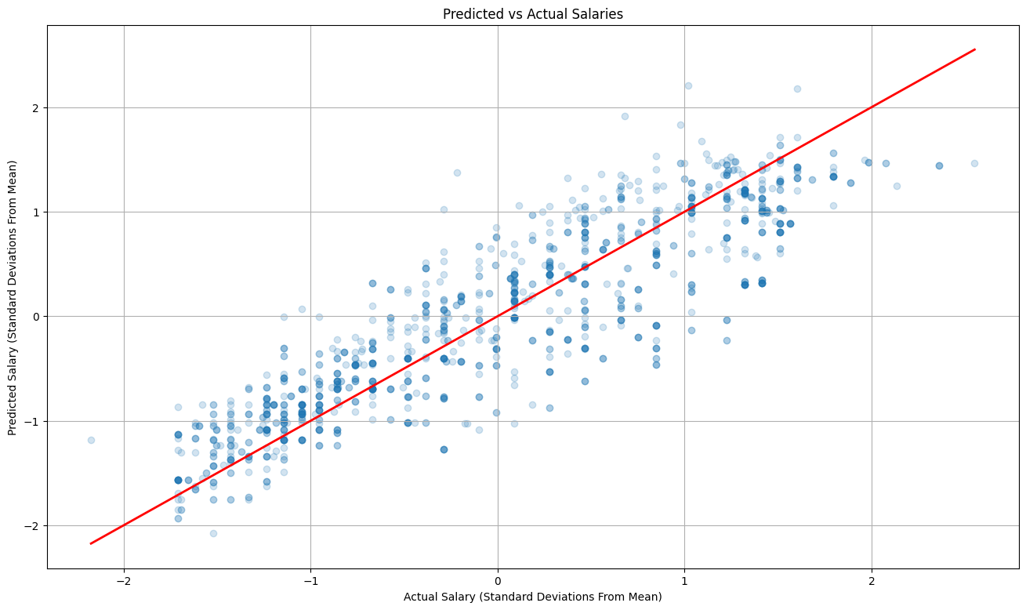
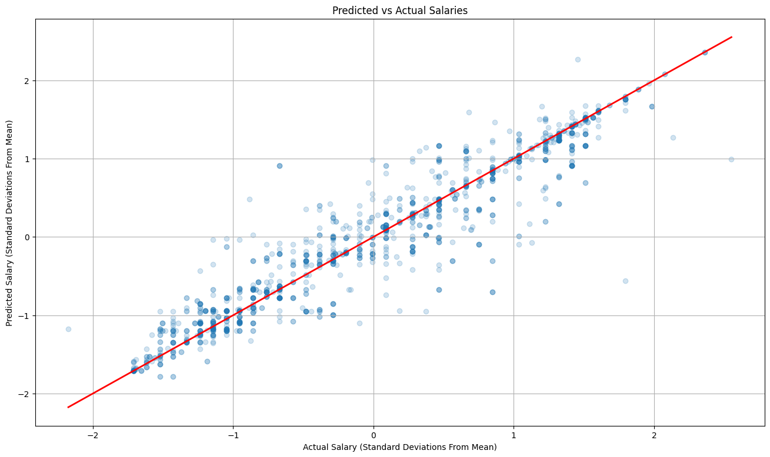
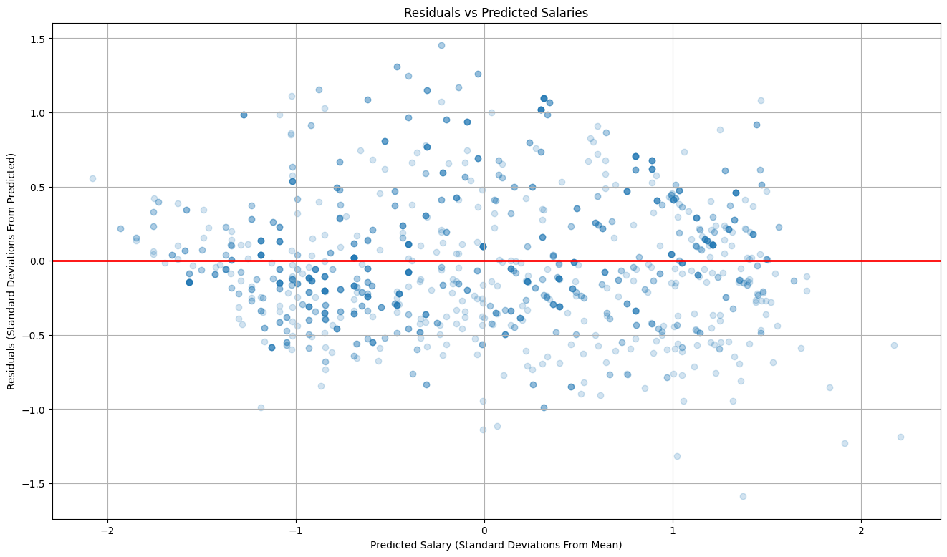
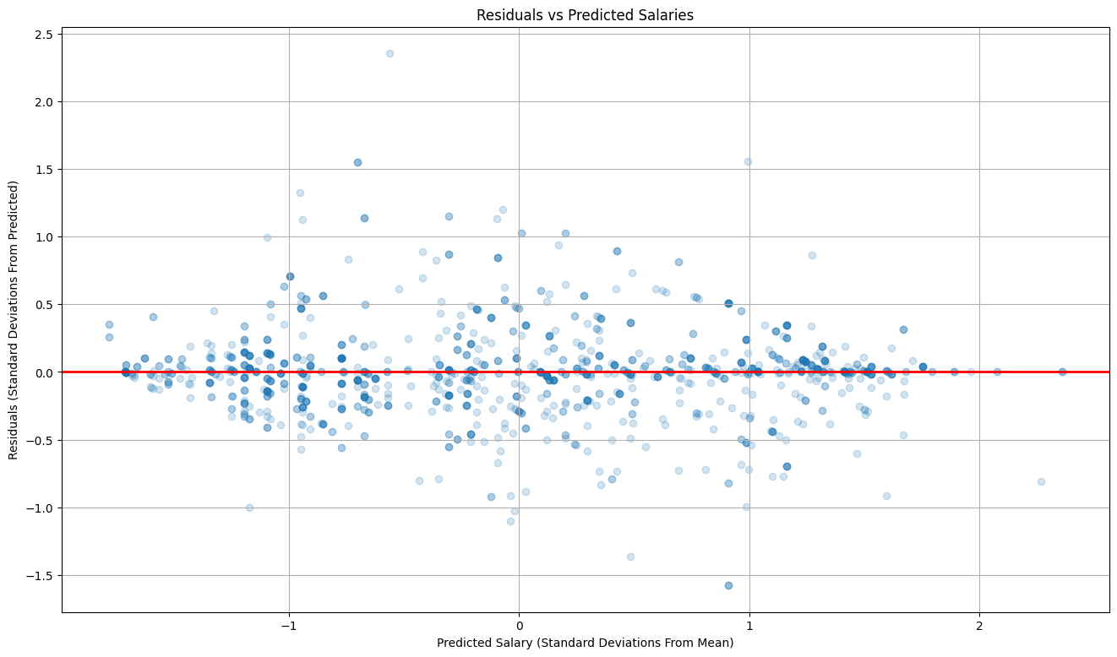

Slide 21
End
Any Questions?

